Slide 1


Md. Rabiul hasan shimul Batch: CBI-033 Python with Django
Blog Nest

Slide 2
Blog Nest is a vibrant platform where writers and readers connect, sharing and discovering diverse content with ease. Its user-friendly interface and customizable tools make blog creation a breeze, while features like comments, likes, and follows nurture a supportive community. Enhanced by SEO optimization, Blog Nest helps blogs reach a broader audience, amplifying visibility. With rich text editing and media embedding, posts on Blog Nest aren't just informative, they're visually stunning and creatively engaging.
Blog Nest

Slide 3
1. Blog Nest is simple with easy-to-use tools and templates. 2. Users connect and support each other through comments and follows. 3. There are many topics to explore, so there's something for everyone. 4. An SEO-friendly setup helps blogs appear in search results, reaching more people. 5. Rich text and media options make blogs creative and appealing.
Why Blog Nest?

Slide 4

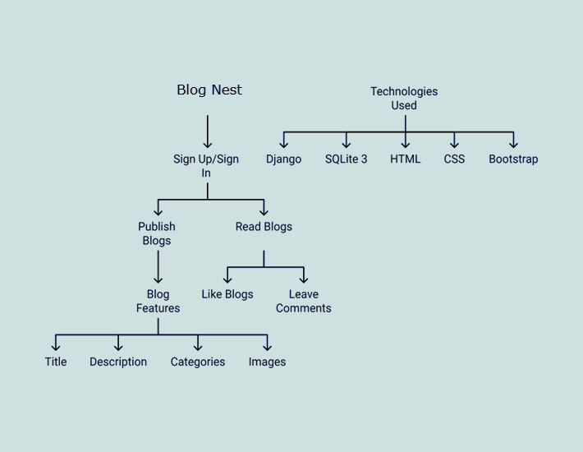
Snapshot of the system

Slide 5
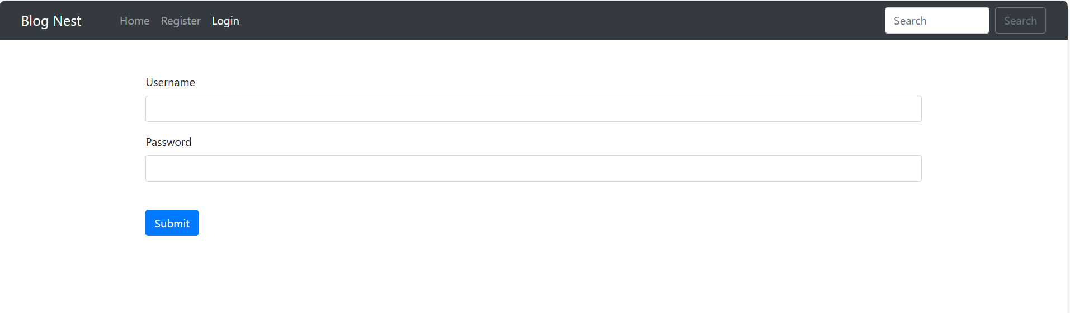
Results
Login Interface

Slide 6
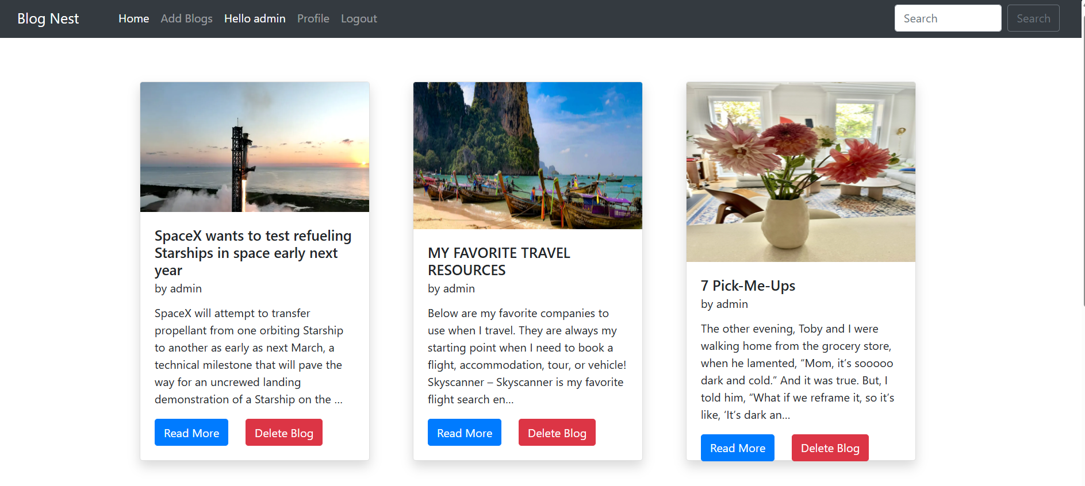
Front Page

Slide 7
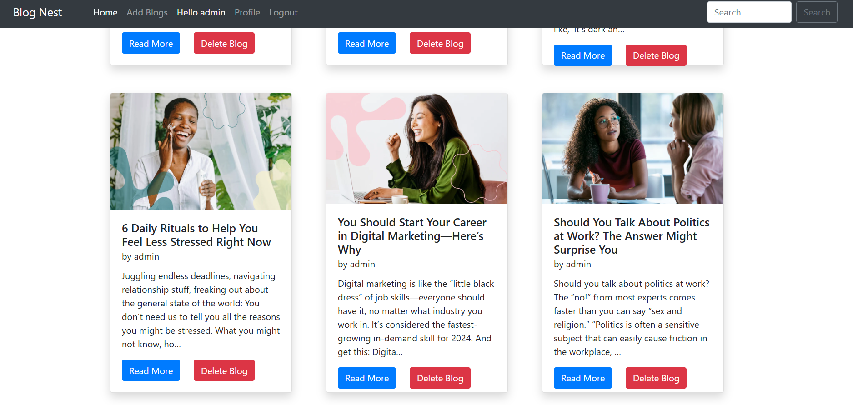
Recent Blogs

Slide 8
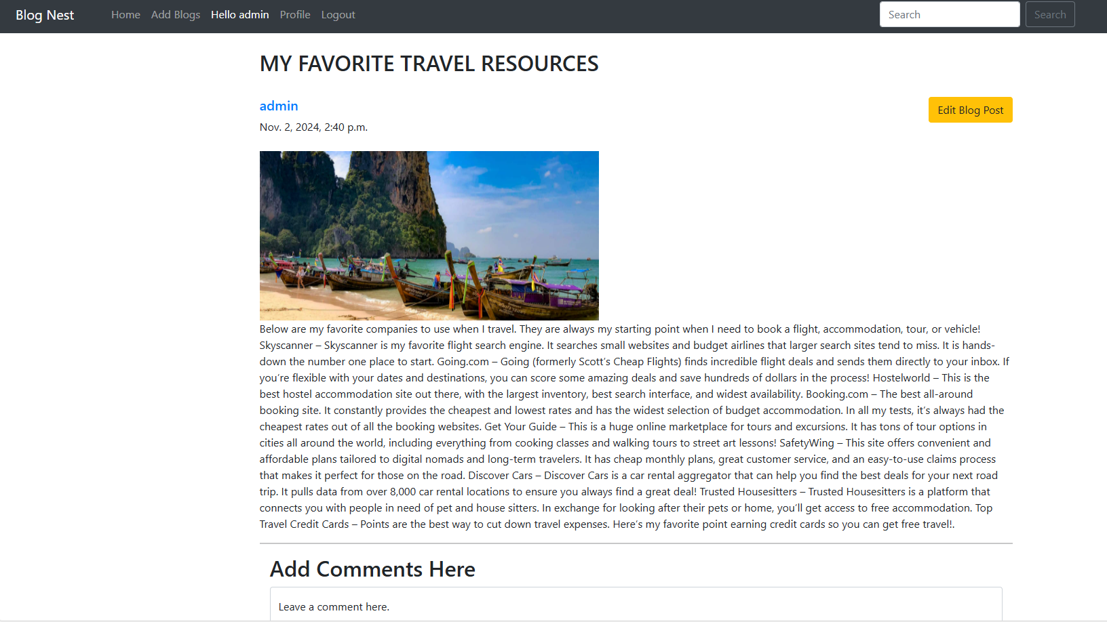
Blog Details

Slide 9
Advantages
Users own their content and data.
Encourages interaction and networking among users.
Allows users to customize their blogs.
Offers ways for users to earn money from their content.
Open-source, so anyone can improve it.

Slide 10
Disadvantages
1. Users need technical skills to set up their blogs.
2. There may not be much customer support available.
3. Users must handle their data security.
4. It can be hard to stand out among many bloggers.
5. Users have to keep their blogs updated and maintained.

Slide 11
Conclusion
Blog Nest stands as a powerful tool for self-expression and community building. Its user-centric approach, allowing for content control and customization, combined with opportunities for monetization, makes it an attractive platform. While users may face some technical hurdles and competition, the rich features and supportive environment ultimately empower individuals to connect and share their voices with the world.

Slide 12
Thank You

